Slide 1

HISTORY OF THE EMERGENCE OF INDEPENDENT BANGLADESH
Dr. Md. Abdul Alim
B. A (Hon’s), M. A (History), M. Phil (Raj), Ph. D (Raj)
Email:doctorabdulalim64@gmail.com
Cell: +880 01718-787466

Slide 2
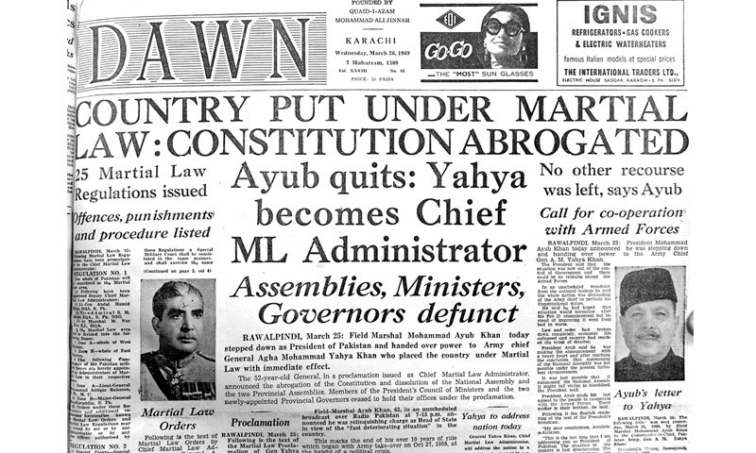
1970 GENERAL ELECTION 1970 GENERAL ELECTIONS
On March 25, 1969, after taking power from Ayub Khan General Yahya announced on November 28, 1969, that he would hand over the power to elected representatives as soon as possible by the adults. The task of these elected representatives will be to give the country a workable system of governance and find the solution to political, economic, and social problems that have influenced people's minds.

Slide 3
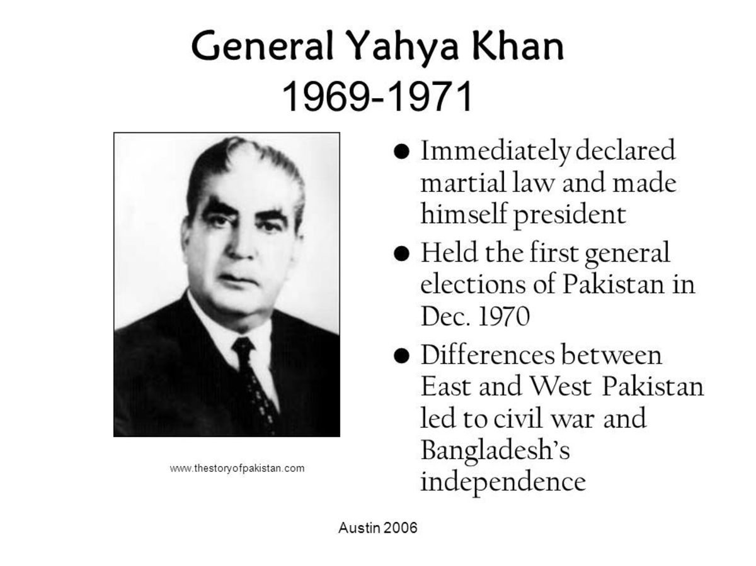
1970 GENERAL ELECTION
As part of the process of hand over of power, Yahya Khan made two important political decisions. First, he is one of the West Pakistan Abolished the unitary system and created four new provinces there. Second, he announced that he would vote on the principle of one vote. The first decision satisfied the people who believed in the regionalism of Pakistan. East through the second decision the demand of Pakistan's majority was accepted. President Yahya Khan announced several other issues as fixed.

Slide 4
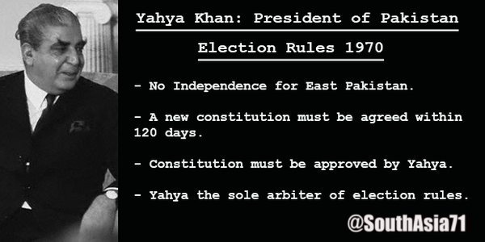
1970 GENERAL ELECTION
These are:
Federal parliamentary type of government.
Direct election based on adult suffrage.
Provision of fundamental rights to citizens and ensuring protection of these rights through courts of law.
Independence of the Judiciary and giving it the role of protector of governance.
One to uphold the ideals on which Pakistan was founded formulation of a governance system based on Islamic ideology.

Slide 5
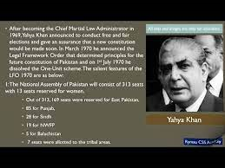
1970 GENERAL ELECTION
On November 28, 1969, Yahya Khan announced that on 5 1970 National Assembly elections and on October 22 Provincial Assembly elections would be held in the country. The task of the mentioned National Assembly will be to formulate a constitution for the country.
He gave a speech to the nation on March 28, 1970, and announced the principles of the Legal framework order. In the mentioned order he declares how the elections and the formation of the National Assembly and its functions will be. The legal structure of the Order was as follows:

Slide 6
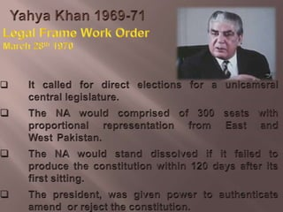
THE LEGAL FRAMEWORK ORDERS
The one-unit scheme in West Pakistan shall be abolished to re-establish the provinces that existed earlier. These provinces shall come into being on 1 July, 1970.
There shall be a National Assembly of Pakistan consisting of 313 members, of whom 13 shall be women, and the five Provincial Legislative Assemblies will be composed of 621 members.

Slide 7
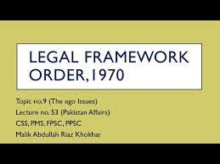
THE LEGAL FRAMEWORK ORDERS
The principle of one person one vote was adopted for the election. The economic and legal responsibilities and power of the two parts of Pakistan shall lie with the elected representatives.
The list of voters shall be prepared by June, 1970.
There were directives on the election as well as the foundation of the constitution. The six basic fundamental principles of the constitution were spelt out in article 20 of the legislative framework order, which were:

Slide 8
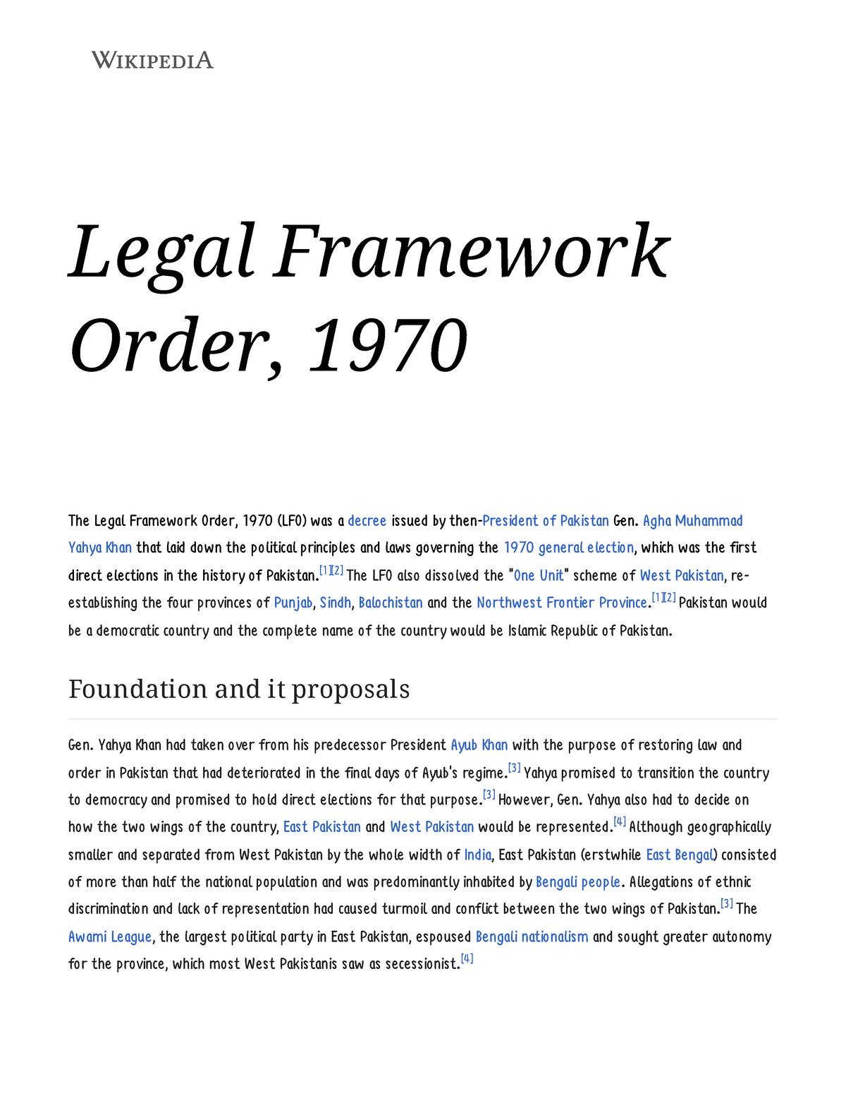
THE LEGAL FRAMEWORK ORDERS
Pakistan shall be a federal republic.
Islamic ideology shall form the base of the state.
Legislatures shall be elected through direct elections on the basis of population and adult franchise.

Slide 9
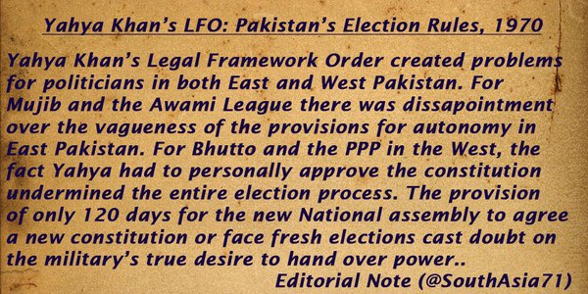
THE LEGAL FRAMEWORK ORDERS
The fundamental rights of the citizens shall be laid down and guaranteed.
Within a specified period, economic and all other disparities between different provinces and areas shall be removed.
The independence of the judiciary shall be secured.

Slide 10
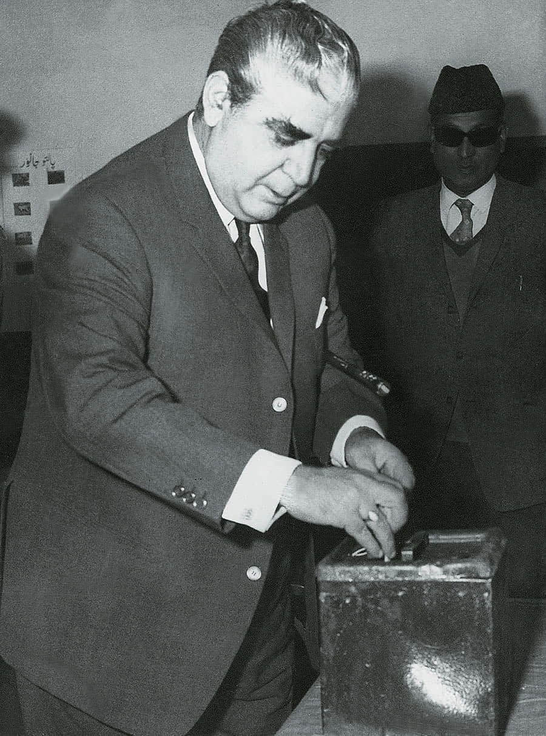
ELECTION MANAGEMENT
On 2 July, 1969, as per the announcement of Yahya Khan, an Election Commission was formed which was headed by justice Abdus Sattar, a justice of Pakistan Supreme Court. The initial task of that Election Commission was to prepare a wide-ranging voter list. Out of the total registered voters in this list, 3,12,14,935 were from East Pakistan and 2,52,06,263 from West Pakistan. The members of ethnic minority groups were included in that voter list.

Slide 11
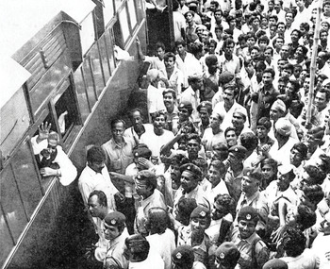
PARTICIPATION DIFFERENT POLITICAL PARTIES IN THE ELECTION
Though the pro-Awami League parties were interested in forming an alliance with Awami League to participate in the election of 1970, the party leader Bangabandhu Sheikh Mujibur Rahman declared to compete in the election independently.

Slide 12
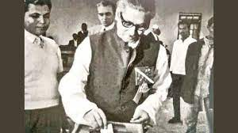
PARTICIPATION DIFFERENT POLITICAL PARTIES IN THE LECTION
As a result, the political parties nominated their candidates separately for the election of 1970. A total of 781 candidates filed nomination papers for that election.
Awami League had 162 candidates running for the National Assembly with the symbol of country boat.

Slide 13
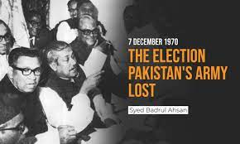
1970 ELECTION RESULT
Awami League won 160 out of 162 seats in the National Assembly in the election of 1970. Awami League emerged as the single largest party in the National Assembly by winning a majority 167 seats that included the reserved seats for women. On the other hand, in the East Pakistan Provincial Assembly, Awami League held the absolute majority by bagging 298 out of a total of 310 seats.

Slide 14
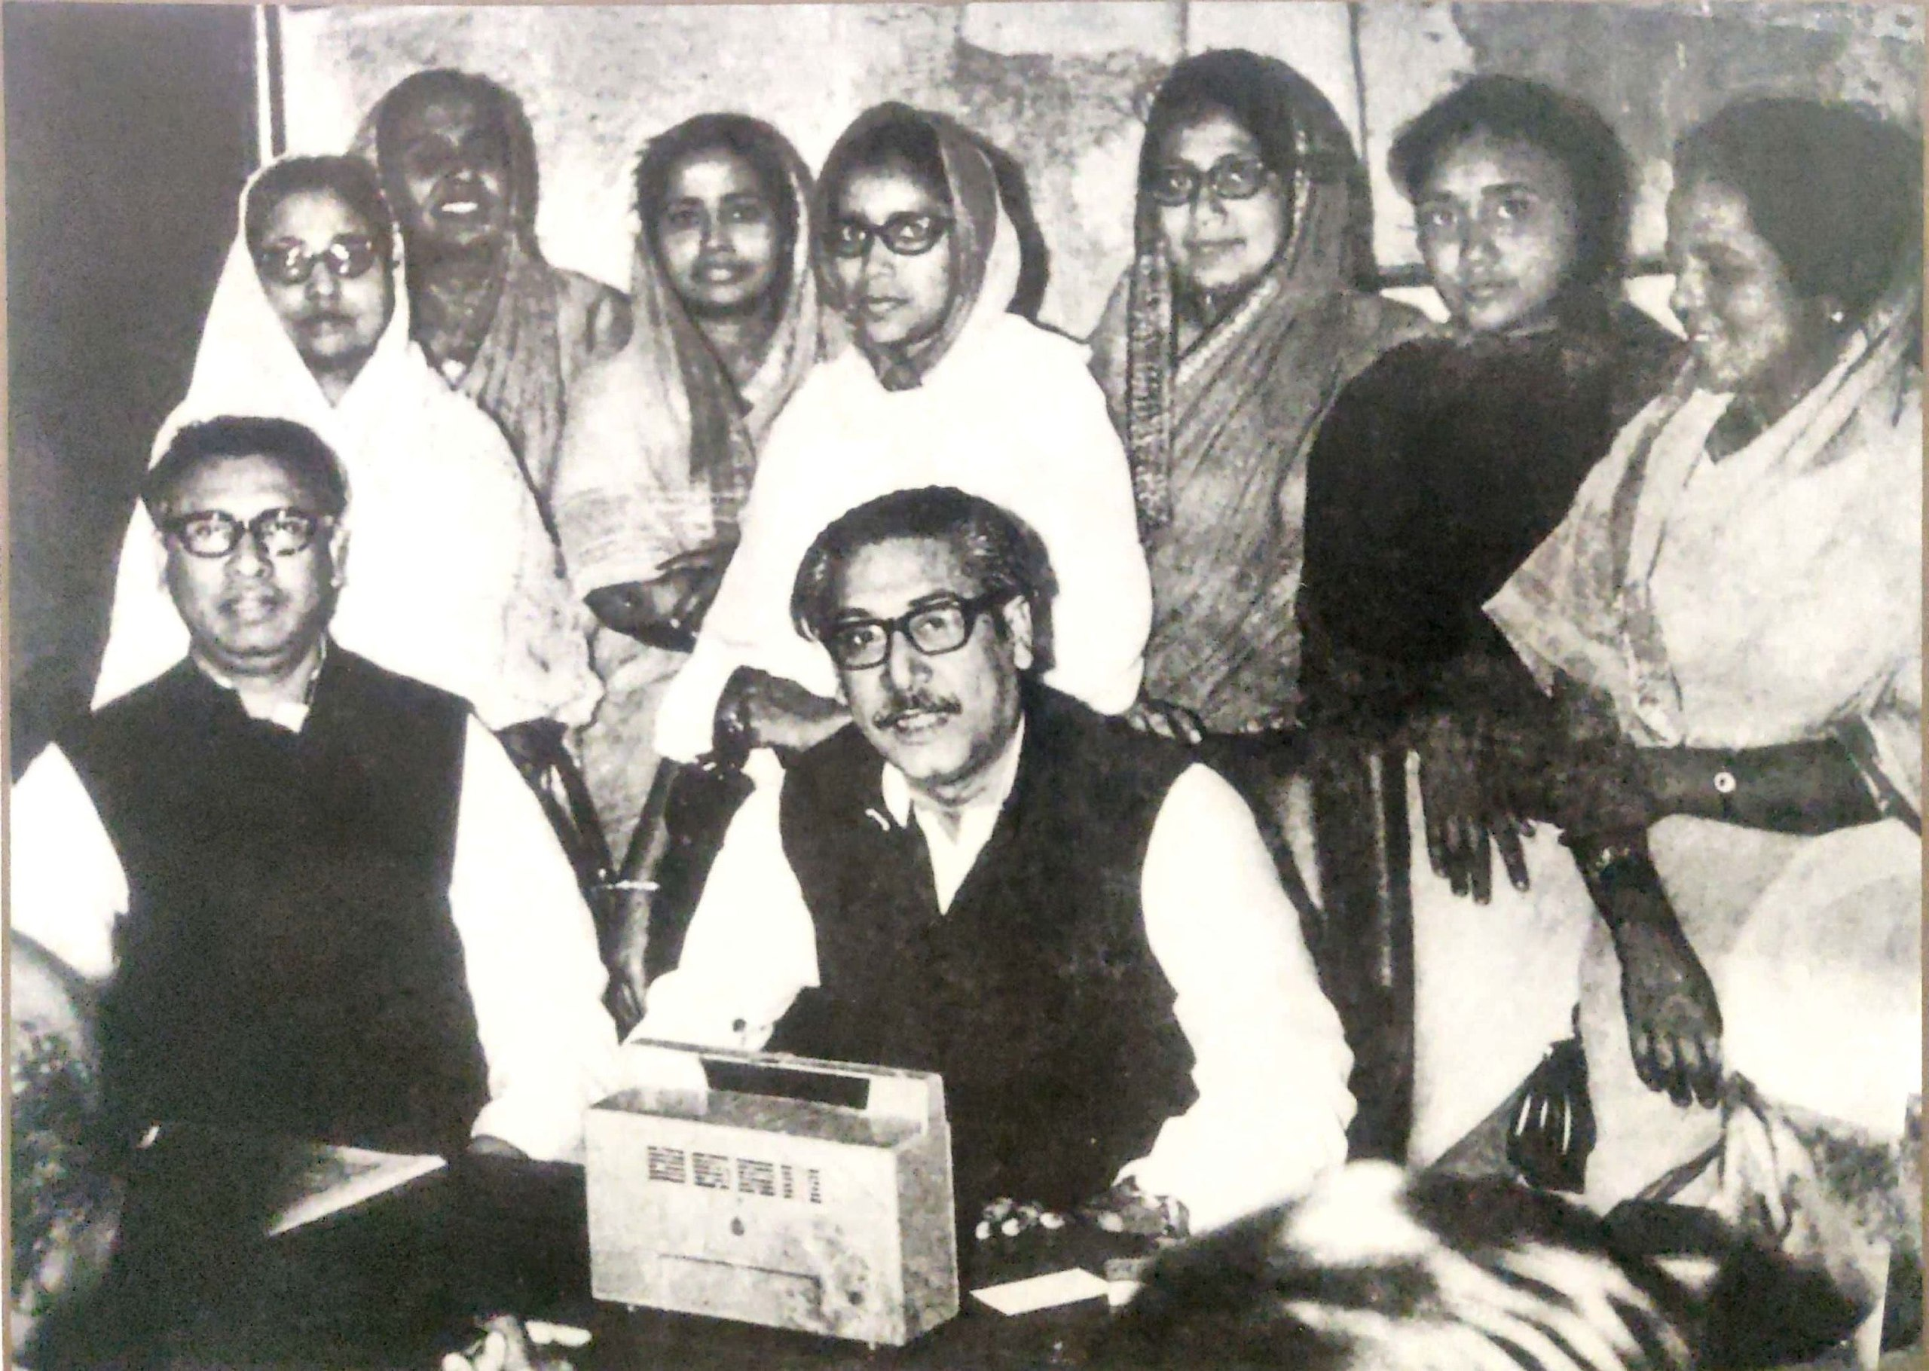
1970 ELECTION RESULT
Among other parties contesting the election were, All Pakistan Central Jamiatul Ulema and Nejame Islam (45), Islamic Democratic Party (5), Jamaat-e-Islami Pakistan (69), Pakistan Democratic Party (81), Pakistan Muslim League (Convention -93), Pakistan Muslim League (Council-50), Pakistan Muslim League (Qayyum-65) etc.

Slide 15
1970 ELECTION RESULT
Regions | National Assembly |  |  | Provincial Assembly
 | General | Women | Total | General | Women | Total
East Pakistan | 162 | 7 | 169 | 300 | 10 | 310
Panjab | 82 | 3 | 85 | 180 | 6 | 186
Sindh | 27 | 1 | 28 | 60 | 2 | 62
Northwest frontier Baluchistan | 18 | 1 | 19 | 40 | 2 | 42
Baluchistan | 4 | 1 | 5 | 20 | 1 | 21
Centrally administered Tribal areas | 7 | - | 7 | - | - | -
Total | 300 | 13 | 313 | 600 | 21 | 621

Slide 16
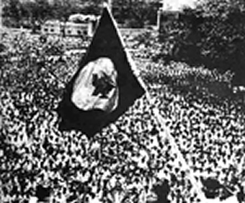
SIGNIFICANCE OF THE ELECTION
The election of 1970 had enormous significance for the emergence of an independent and sovereign Bangladesh and Bangalee nationalism. That was the most free and fair election after the election of 1954. The uniqueness that Banglaee as a nation had been voicing since 1947, the election of 1970 marked the victory of that preparedness. Moreover, the autonomy that had been claimed by the people of the Eastern province was declared illegal by the western government.

Slide 17
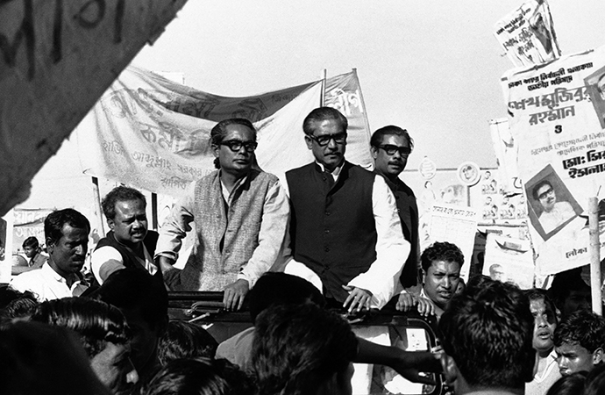
SIGNIFICANCE OF THE ELECTION
The demand for the six point based autonomy was proved to be valid due to this election. Overall, following his announcement, Yahya Khan refused to transfer the power when the time for handing it over to the elected government came and, instead, directed military attacks on innocent Bangalees. That was the beginning of the armed struggle for liberation of the people of Bengal, which eventually resulted in the emergence of an independent state in the world named Bangladesh on 16th December.

Slide 18
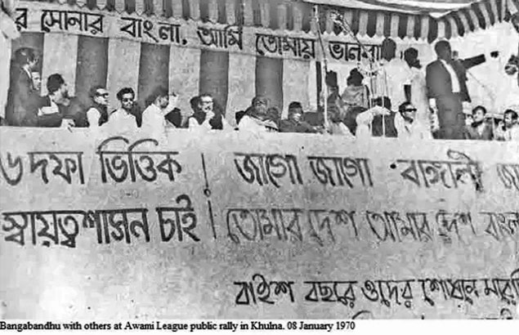
THE NON-COOPERATION MOVEMENT, AND THE INDEPENDENCE OF BANGABANDHU
Awami League earned the right to initiate the formation of government by dint of its absolute majority in the National and Provincial Assemblies. But the military ruler of Pakistan Yahya Khan started to show his reluctance in handing over the power to the hands of Awami League. He was provoked by Zulfiker Ali Bhutto to declare the meeting of National Assembly scheduled on 3 March 1971.

Slide 19
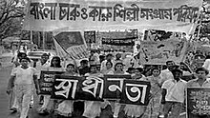
THE NON-COOPERATION MOVEMENT, AND THE INDEPENDENCE OF BANGABANDHU
As soon as the declaration came, the common people of East Pakistan, including students, workers, government and non-government officers and employees, burst into violent protest. People attacked Pakistani soldiers at different places. Many people were killed and injured due to the clashes. On that day, the leaders of the Student League formed the "Swadhin Bangla Chattro Sangram Parishad". This organization called for a country-wide general strike on 2 March. The flag of Bangladesh was hoisted on this very day at a student rally at Dhaka University.

Slide 20
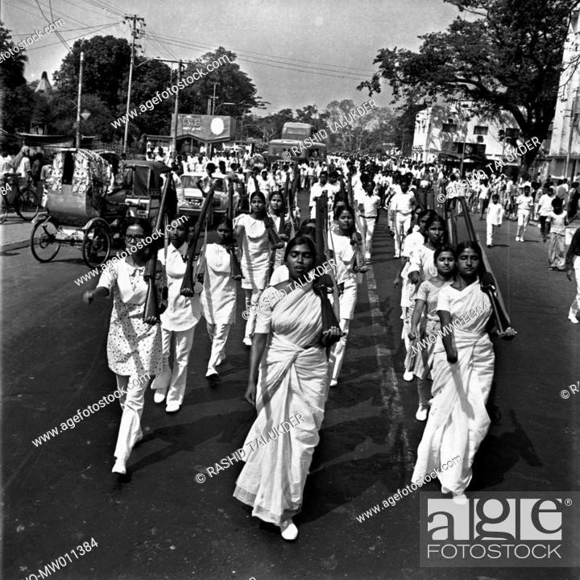
THE NON-COOPERATION MOVEMENT, AND THE INDEPENDENCE OF BANGABANDHU
Students, teachers and lawyers left their workplaces to show their adherence to the movement. The movement all over the country including Dhaka got the momentum by those three days of hartal. Many people were gunned down and injured as the police fired at many places during those public-police clashes.

Slide 21
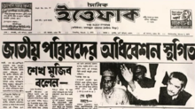
THE NON-COOPERATION MOVEMENT, AND THE INDEPENDENCE OF BANGABANDHU
Yahya khan got frightened at that circumstance and on 6 march in a betar (Radio) address, he was bound to announce the convention of National Assembly on 25 March. But his announcement could not reassure the fuming wrath of the people of Bangladesh. The unprecedented leader of Bangladesh Bangabandhu could not put his trust on that declaration too. Consequently, a grand rally was arranged on 7 March at the racecourse ground (at present, Sohrawardi Uddyan) on behalf of the Awami League to organize stronger movements protesting the military rule.

Slide 22
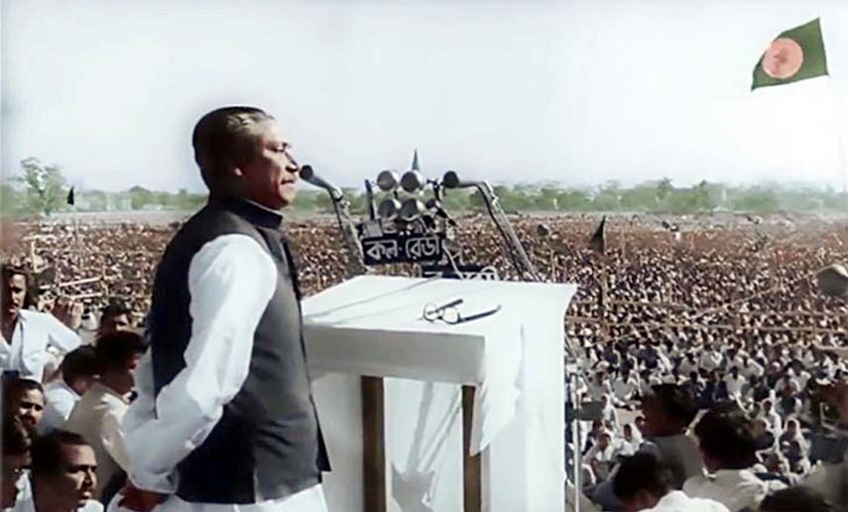
THE 7TH MARCH SPEECH OF BANGABANDHU
March 07, 1971, the speech given by Bangabandhu Sheikh Mujibur Rahman at the Race Course Maidan (now Suhrawardy Udyan) on that day to an audience of a million people shaped our destiny. , Bangabandhu gave his signal to the people he loved to a fault – "Ebarer sangram amader muktir sangram!" It was our battle for emancipation this time

Slide 23
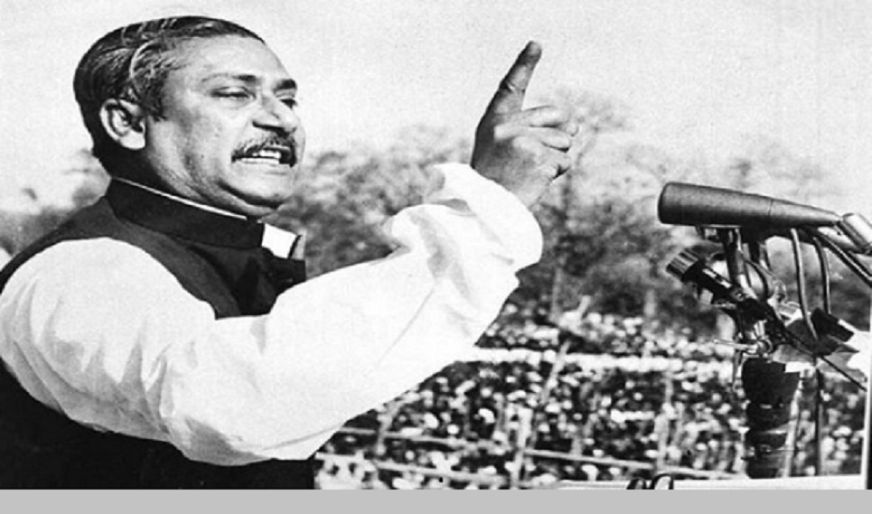
THE 7TH MARCH SPEECH OF BANGABANDHU
In his speech, he said that if 4 conditions are fulfilled, he will join the session. They are:
1. Martial law must be withdrawn immediately. 2. Military men should go back to barracks 3. Genocide must be investigated 4. Power must be transferred to the people's representatives.

Slide 24
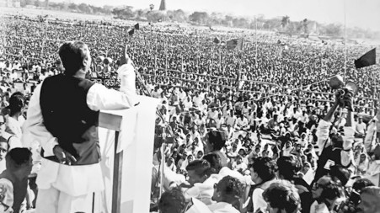
THE 7TH MARCH SPEECH OF BANGABANDHU
He forbade the people of Bengal to pay rent-tax. All the courts of East Pakistan, including the secretariat, other government and semi-government offices, the Supreme Court and the High Court, were asked to remain closed. However, he allowed to keep the bank open only for 2 hours daily. Allowed all types of bus-trucks, rickshaws, taxis for the transportation of common people except military forces.

Slide 25
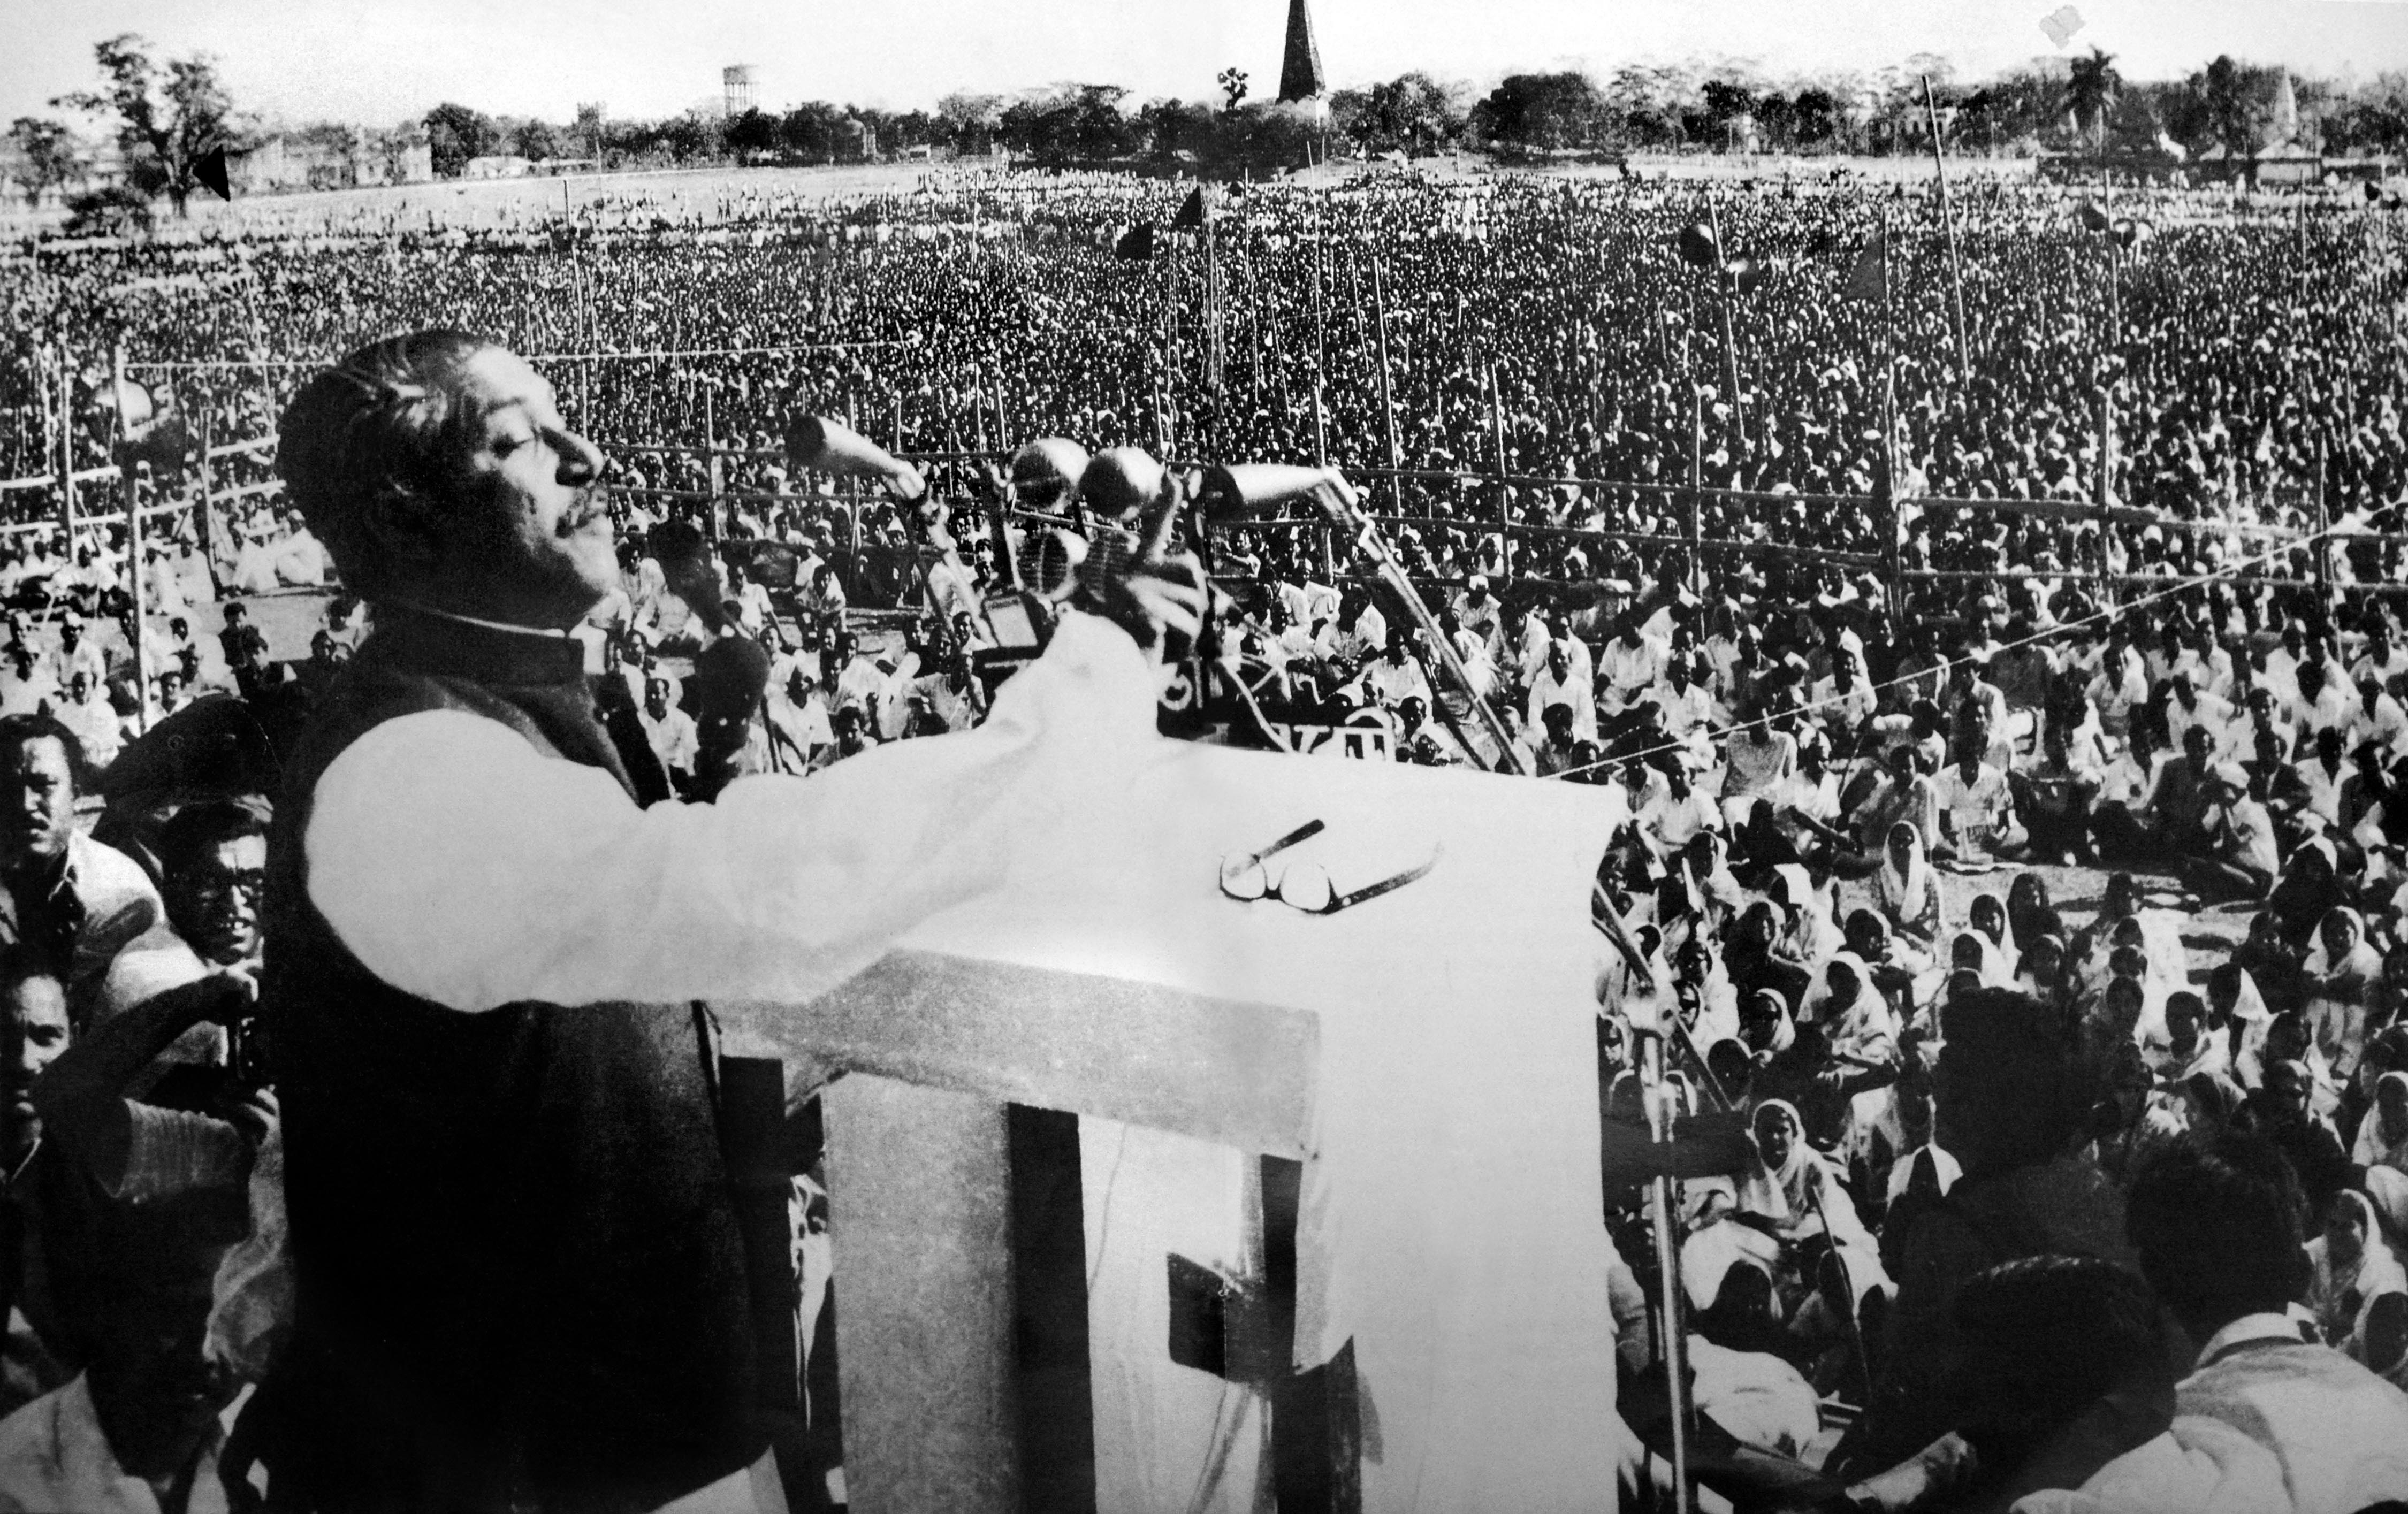
THE 7TH MARCH SPEECH OF BANGABANDHU
Thus, history was created on March 7, 1971. The liberation war of Bangladesh was to begin eighteen days later, when Yahya Khan treacherously stopped talking to Bangabandhu and the army carried out Operation Searchlight, massacring students, teachers and innocent civilians! 'Pakistan lay buried under corpses', said Tajuddin Ahmad, the wartime Prime Minister, a few days later at Mujibnagar.

Slide 26


